Slide 1
Research Integrity:
Principles and Practices for Responsible Research
1
Giovanbattista Califano, PhD
giovanbattista.califano@unina.it
https://califano.xyz/ri

Slide 2
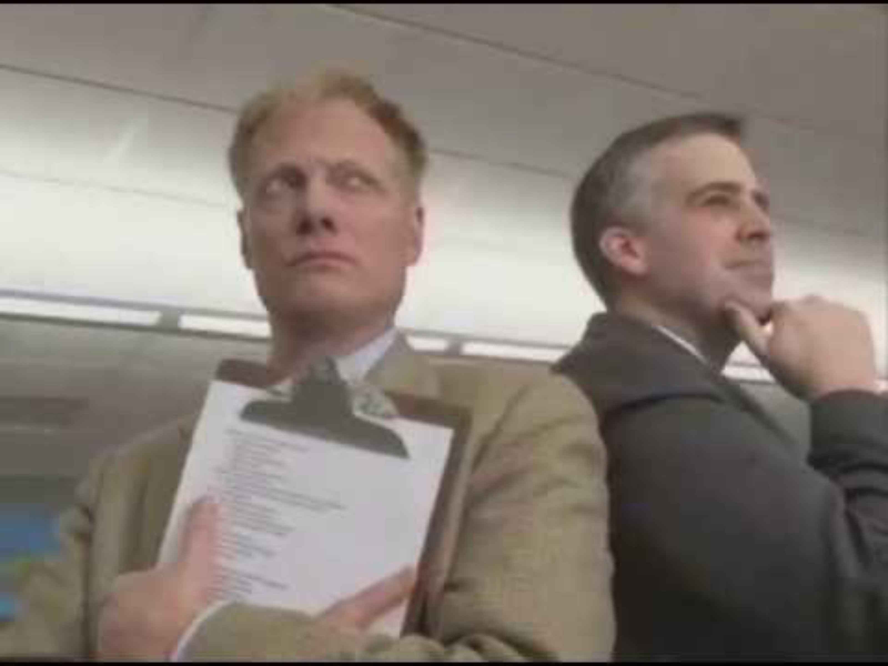

Slide 3
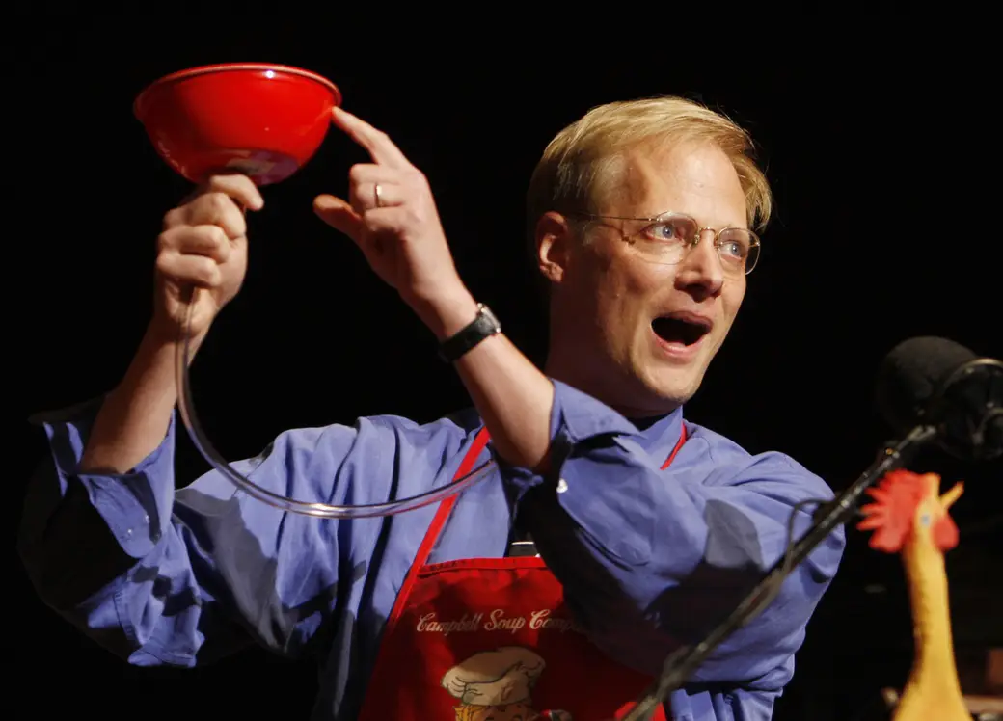
Prof. Brian Wansink
Stan Honda / AFP / Getty Images

Slide 4
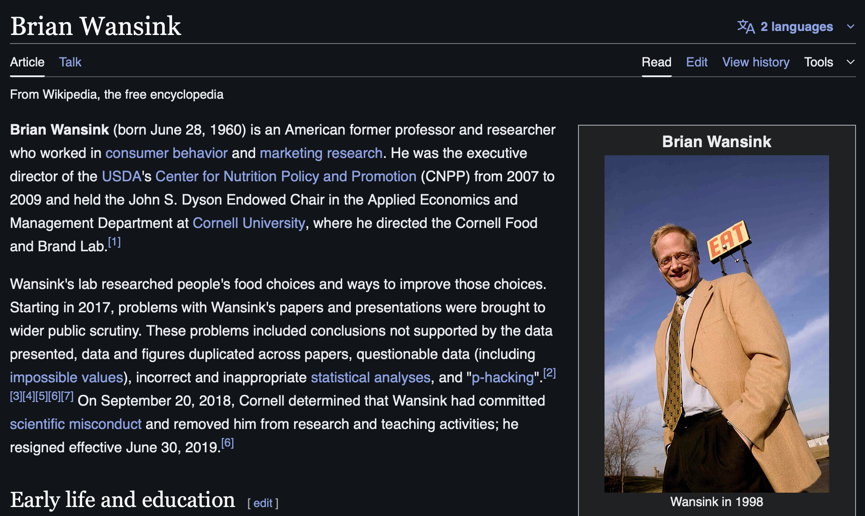

Slide 5
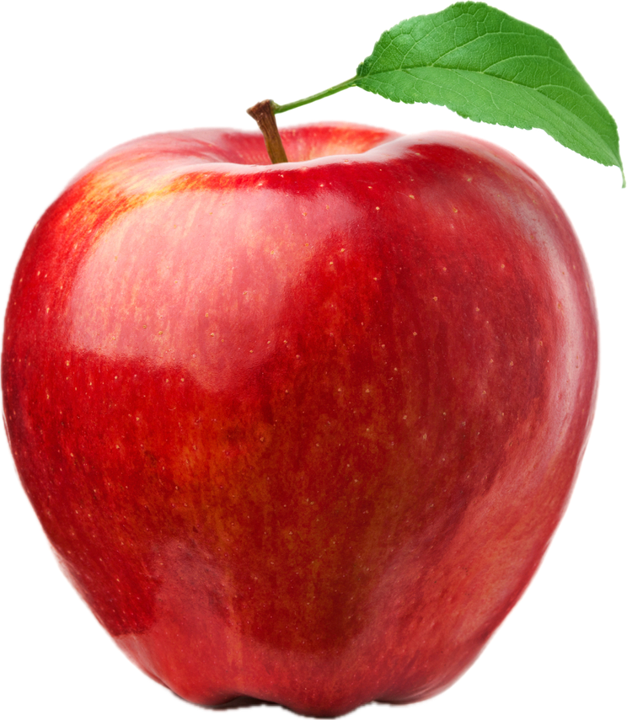
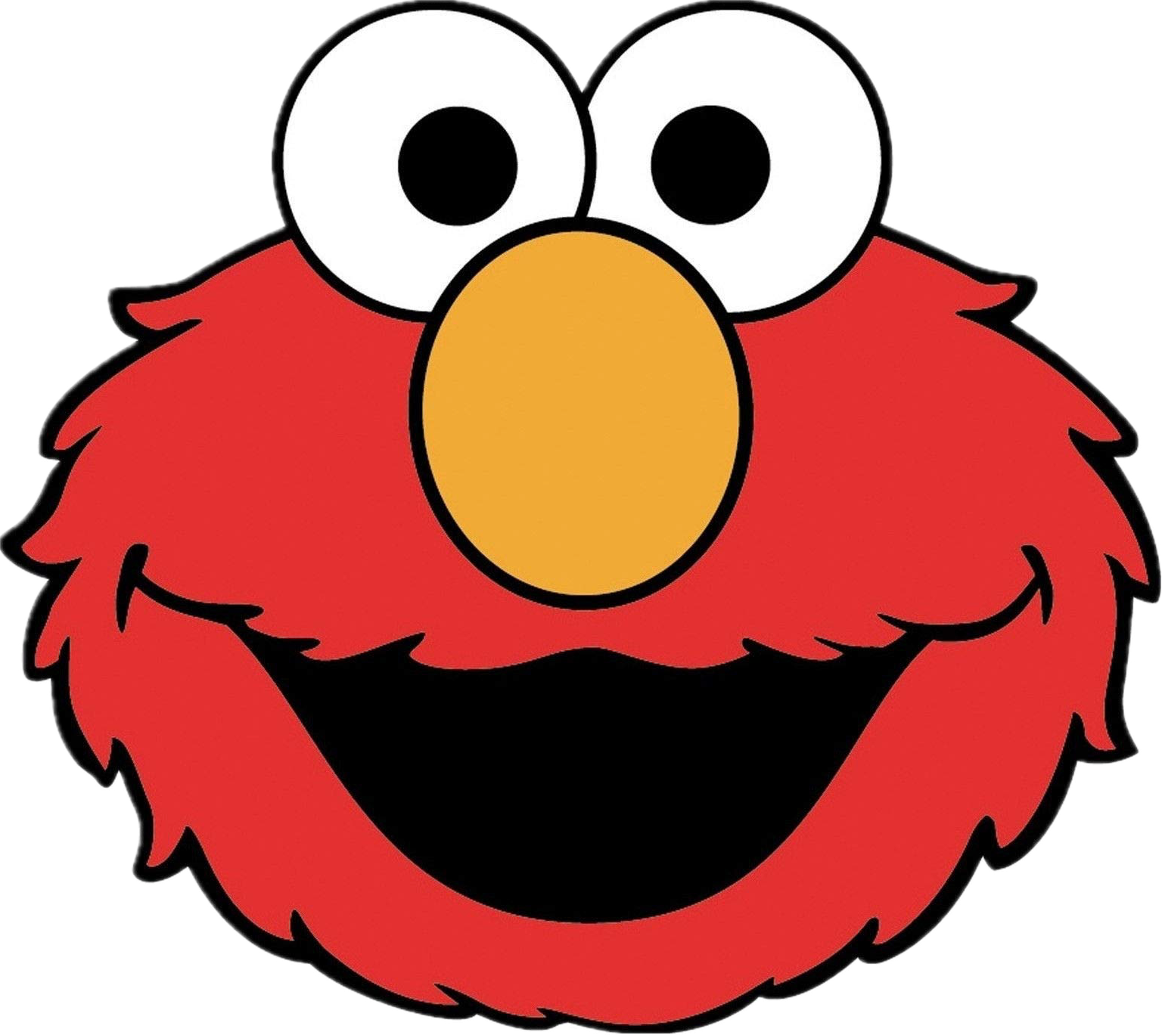
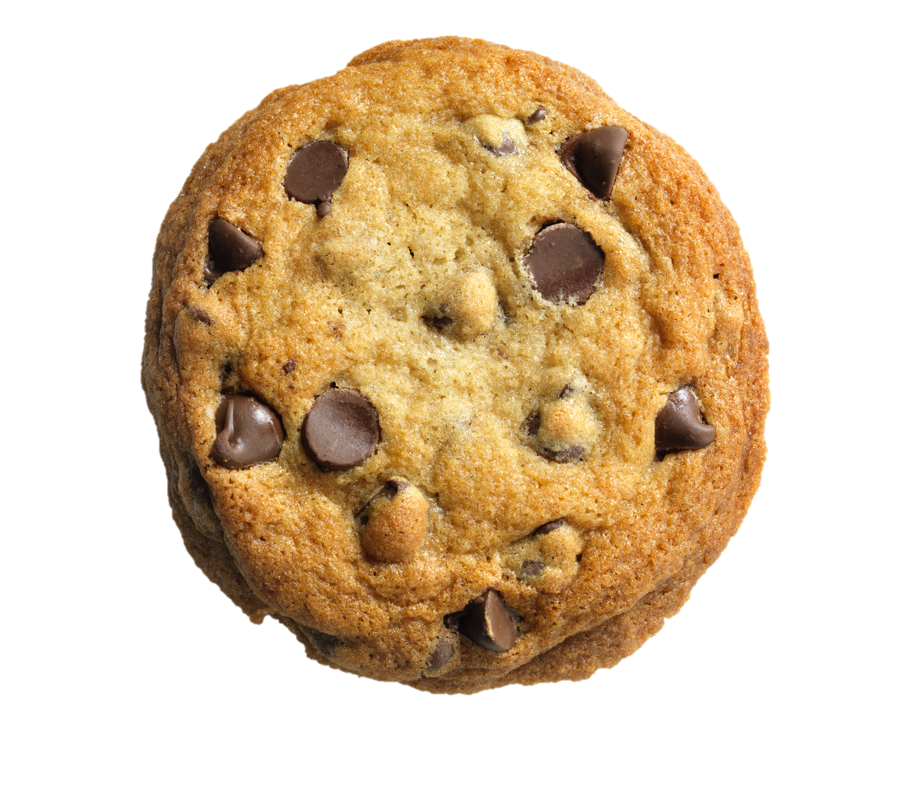

Slide 8
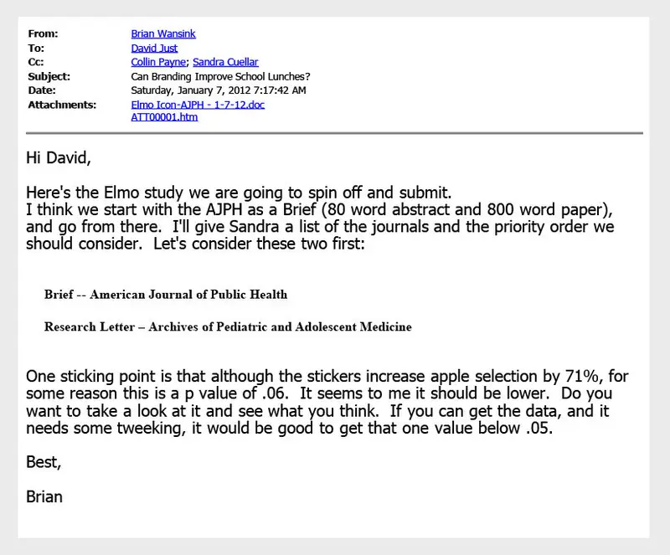
BuzzFeed News

Slide 9
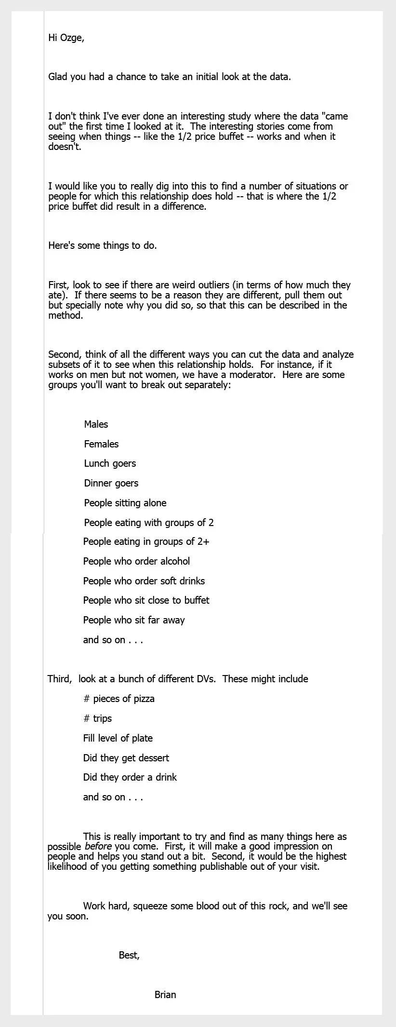
BuzzFeed News

Slide 10
From Brian Wansink’s blog post: The grad student who never said ‘no’
When she arrived, I gave her a data set of a self-funded, failed study which had null results (it was a one month study in an all-you-can-eat Italian restaurant buffet where we had charged some people ½ as much as others). I said, "This cost us a lot of time and our own money to collect. There's got to be something here we can salvage because it's a cool (rich & unique) data set. I had three ideas for potential Plan B, C, & D directions (since Plan A had failed). I told her what the analyses should be and what the tables should look like. I then asked her if she wanted to do them.
Every day she came back with puzzling new results, and every day we would scratch our heads, ask "Why," and come up with another way to reanalyze the data with yet another set of plausible hypotheses. Eventually we started discovering solutions that help up regardless of how we pressure-tested them. I outlined the first paper, and she wrote it up, and every day for a month told her how to rewrite it and she did. This happened with a second paper, and then a third paper (which was one that was based on her own discovery while digging through the data).

Slide 11
From Brian Wansink’s blog post: The grad student who never said ‘no’
When she arrived, I gave her a data set of a self-funded, failed study which had null results (it was a one month study in an all-you-can-eat Italian restaurant buffet where we had charged some people ½ as much as others). I said, "This cost us a lot of time and our own money to collect. There's got to be something here we can salvage because it's a cool (rich & unique) data set. I had three ideas for potential Plan B, C, & D directions (since Plan A had failed). I told her what the analyses should be and what the tables should look like. I then asked her if she wanted to do them.
Every day she came back with puzzling new results, and every day we would scratch our heads, ask "Why," and come up with another way to reanalyze the data with yet another set of plausible hypotheses. Eventually we started discovering solutions that help up regardless of how we pressure-tested them. I outlined the first paper, and she wrote it up, and every day for a month told her how to rewrite it and she did. This happened with a second paper, and then a third paper (which was one that was based on her own discovery while digging through the data).
Examples of questionable research practices (QRPs) that inflate false positives:
HARKing
Hypothesizing After Results are Known
P-hacking
Tweaking data/analyses (stopping early, removing outliers) until a p < 0.05 result appears.

Slide 12
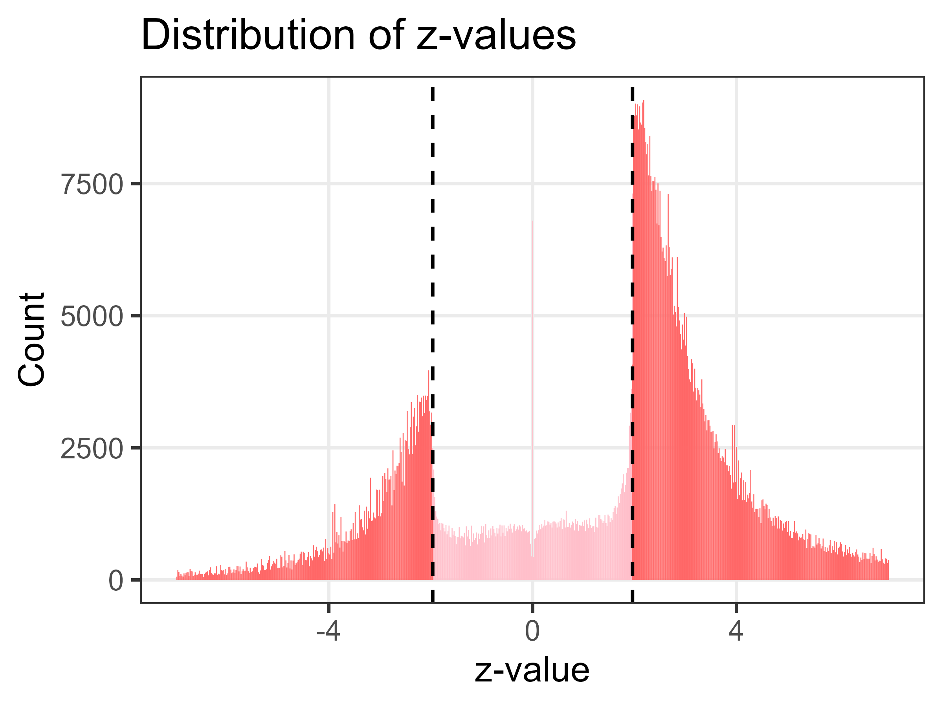
Adrian Barnett, 2022

Slide 13
ETHICS
Doing the right things
INTEGRITY
Doing the things right

Slide 14
ETHICS
Doing the right things
INTEGRITY
Doing the things right
Bad integrity can become an ethical harm

Slide 15
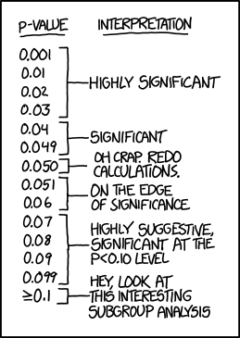
Principles (ALLEA, 2023)
from XKCD

Slide 16
Principles (ALLEA, 2023)
Reliability in ensuring the quality of research, reflected in the design, methodology, analysis, and use of resources.
Honesty in developing, undertaking, reviewing, reporting, and communicating research in a transparent, fair, full, and unbiased way.
Respect for colleagues, research participants, research subjects, society, ecosystems, cultural heritage, and the environment.
Accountability for the research from idea to publication, for its manage­ment and organisation, for training, supervision, and mentoring, and for its wider societal impacts.

Slide 17
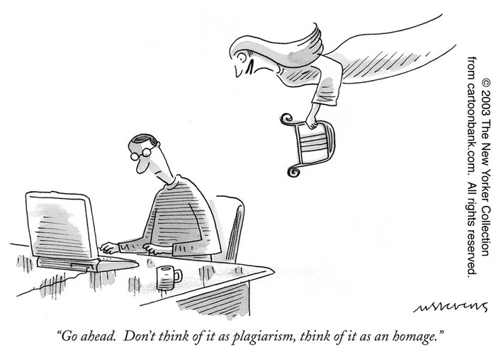
Violations of Research Integrity (ALLEA, 2023)

Slide 18
Violations of Research Integrity (ALLEA, 2023)
FFP
QRP
Fabrication, Falsification, Plagiarism
Questionable Research Practice
Fabrication is making up data or results and recording them as if they were real.
Falsification is manipulating research materials, equipment, images, or processes, or changing, omitting, or suppressing data or results without justification.
Plagiarism is using other people’s work or ideas without giving proper credit to the original source.
Some examples P-hacking HARKing Cherry-picking Salami slicing
Severe misconduct –– Intentional –– Rare
Grey area –– Frequent

Slide 19
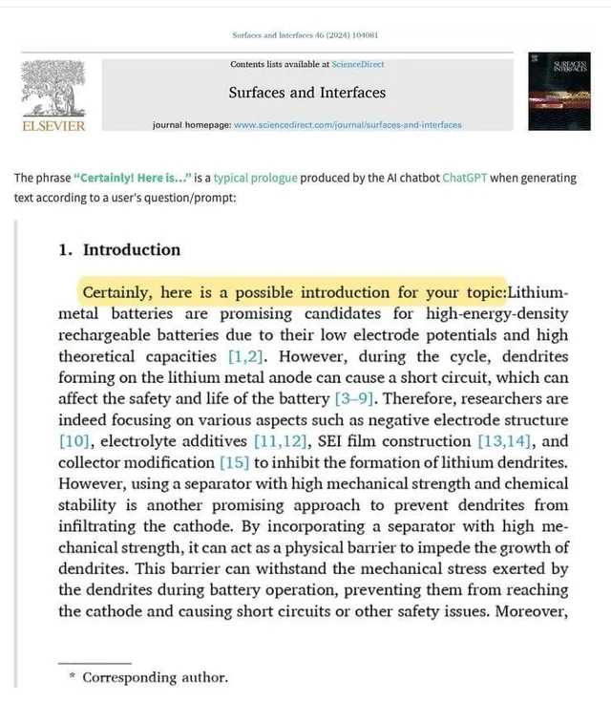
And what about AI?

Slide 20
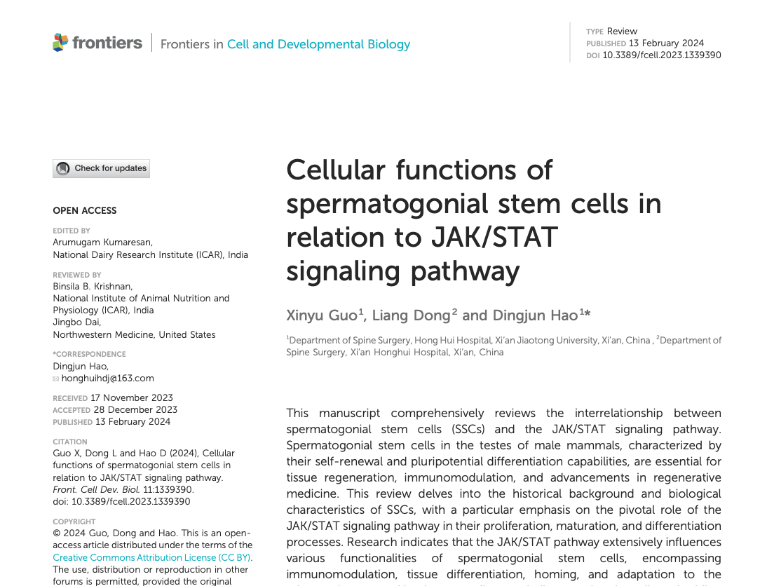
Guidelines on the Responsible Use of Generative AI in Research (European Commission, 2025)
Remain ultimately responsible for scientific output
Use generative AI transparently.
Pay particular attention to issues related to privacy, confidentiality and intellectual property rights when sharing sensitive or protected information with AI tools.
Respect applicable national, EU and international legislation.
Continuously learn how to use generative AI tools properly to maximise their benefits, including by undertaking training.
Refrain from using generative AI tools substantially in sensitive activities that could impact other researchers or organisations (for example peer review, evaluation of research proposals, etc).

Slide 22
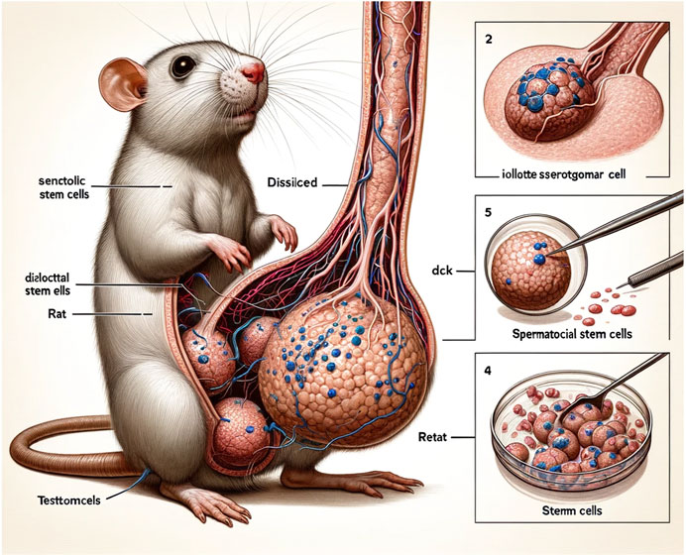

Slide 23
Materials:
Required
Recommended
ALLEA. (2023). The European code of conduct for research integrity (Revised ed.). https://allea.org/portfolio-item/european-code-of-conduct-2023
Barnett, A. (2022). Publication bias or research misconduct? Median Watch. https://medianwatch.netlify.app/post/z_values/
European Commission. (2025). Living guidelines on the responsible use of generative AI in research. https://research-and-innovation.ec.europa.eu/document/2b6cf7e5-36ac-41cb-aab5-0d32050143dc_en
Lee, S. M. (2018). Here’s how Cornell scientist Brian Wansink turned shoddy data into viral studies about how we eat. BuzzFeed News. https://www.buzzfeednews.com/article/stephaniemlee/brian-wansink-cornell-p-hacking
Nature Podcast. (2025). Research misconduct: How the scientific community is fighting back [Audio podcast episode]. Nature. https://www.nature.com/articles/d41586-025-02877-0
Van Dis, E. A., Bollen, J., Zuidema, W., Van Rooij, R., & Bockting, C. L. (2023). ChatGPT: Five priorities for research. Nature, 614(7947), 224–226. https://doi.org/10.1038/d41586-023-00288-7

